Slide 1
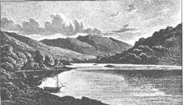
The
Romantic Period
Week One
http://www.wwnorton.com/college/english/nael/romantic/topic_1/guide.htm

Slide 2
Time: late 18th century to the mid-19th century
The Augustan Writers vs. the Romantic Writers: Reason/Objectivity vs. Imagination/Individuality
Prominent Genre: Lyric Poetry, Novel

Slide 3
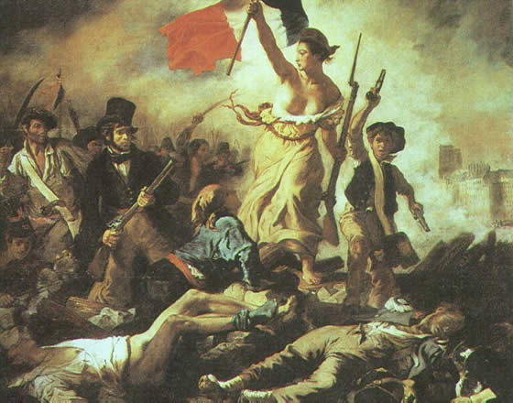
Revolutions
The American Revolution
The French Revolution
The Industrial Revolution
http://www.wwnorton.com/college/english/nael/
romantic/topic_3/illustrations/imdelacroix.htm

Slide 4
Question
What has the changing time to do with the need for heightened individuality and creativity?

Slide 5
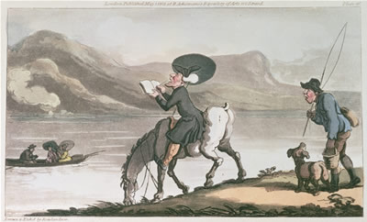
The Solitary Poet
Sublime
Sensibility
The Roman-
tics and the
Augustans
http://www.wwnorton.com/college/english/nael/romantic/
topic_1/illustrations/doctorsyntax.htm

Slide 6
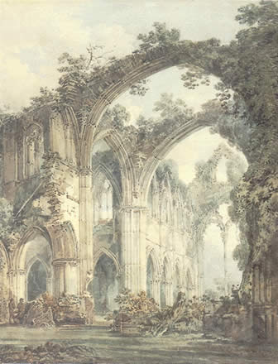
William Wordsworth
The Lyrical Ballads (1798)
Language: “really used” by people
Subject Matter: “humble and rustic life”
Spontaneous Feelings
Nature vs. Society
Coleridge, William Blake, Percy Shelley, and John Keats
http://www.wwnorton.com/college/english/nael/
romantic/topic_1/illustrations/imtinternabbey.htm

Slide 7
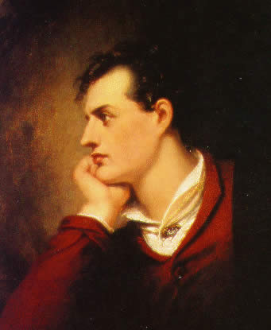
Lord Byron
Satirist
Byronic Hero: Heathcliff from Emily Brontë’s Wuthering Heights (1847), Satan in Milton’s Paradise Lost
Sensitivity and Humanity
http://www.wwnorton.com/college/english/nael/
romantic/topic_5/illustrations/imwestall.htm

Slide 8
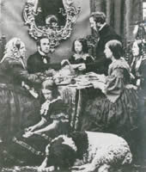
Jane Austen
Impassioned Individualism vs. Good Sense & Self-restraint
Pride and Prejudice
http://www.wwnorton.com/college/english/nael/
victorian/topic_2/illustrations/imtea.htm

Slide 9
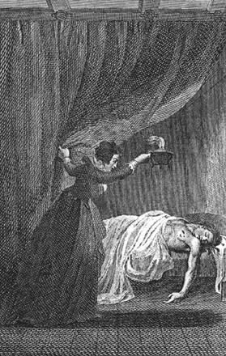
Gothic Novels
Denouncement against the outmoded ideals of chivalry and Catholicism for middle-class, Protestant readers.
Ann Radcliffe’s The Mysteries of Udolpho (1794)
http://www.wwnorton.com/college/
english/nael/romantic/topic_2/
illustrations/imvol4.htm

Slide 10
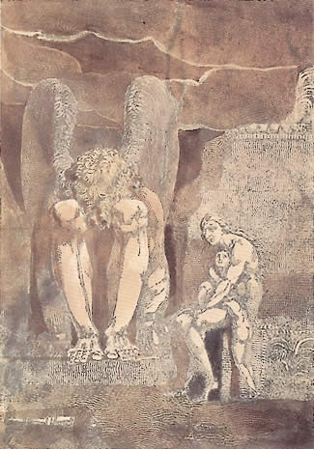
William Blake
1757-1827
Songs of Innocence
Songs of Experience
Speaks always for the primacy of the individual and the imagination.
http://www.wwnorton.com/college/english/nael/
romantic/topic_3/illustrations.htm

Slide 11
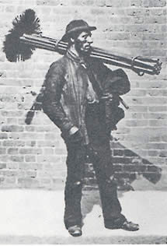
Songs of Innocence (1789)
An Imaginative picture of the state of innocence
Reflection of the growing Romantic fascination with childhood and a supposed primitive condition of human perfection in innocence
http://www.wwnorton.com/college/
english/nael/victorian/topic_1/
illustrations/imsweep.htm

Slide 12
introduction
Piping down the valleys wild
Piping songs of pleasant glee
On a cloud I was a child,
And he laughing said to me,
“Pipe a song about a Lamb”;
So I piped with merry chear;
“Piper pipe that song again”—
So I piped, he wept to heat

Slide 13
introduction
“Drop thy pipe thy happy pipe
Sing thy songs of happy chear”;
So I sung the same again
While he wept with joy to hear.
“Piper sit thee down and write
In a book that all may read”—
So he vanish’d from my sight.
And I pluck’d a hollow reed,

Slide 14
introduction
And I made a rural pen,
And I stain’d the water clear,
And I wrote my happy songs
Every child may joy to hear.

Slide 15
The Lamb
Little Lamb, who made thee?
Dost thou know who made thee?
Gave thee life & bid thee feed,
By the stream & o’er the mead;
Gave thee clothing of delight,
Softest clothing wooly bright;
Gave thee such a tender voice,
Making all the vales rejoice!

Slide 16
The Lamb
Little Lamb who made thee?
Dost thou know who made thee?
Little Lamb I’ll tell thee,
Little Lamb I’ll tell thee!
He is callèd by thy name,
For he calls himself a Lamb;
He is meek & he is mind,
He became a little child;

Slide 17
The Lamb
I a child & thou a lamb,
We are callèd by his name.
Little Lamb God bless thee.
Little Lamb God bless thee.

Slide 18
The Chimney sweeper
When my mother died I was very young,
And my father sold me while yet my tongue
Could scarcely cry “’weep! ‘weep! ‘weep! ‘weep!”
So your chimneys I sweep & in soot I seep.
There’s little Tom Dacre, who cried when his head
That curl’d like a lamb’s back, was shav’d, so I said,
“Hush, Tom! never mind it, for when your head’s bare,
You know that the soot cannot spoil your white hair.”

Slide 19
The Chimney sweeper
And so he was quite, & that very night,
As Tom was a-sleeping he had such a sight!
That thousands of sweepers, Dick, Joe, Ned, & Jack,
Were all of them lock’d up in coffins of black;
And by came an Angel who had a bright key,
And he open’d the coffins & set them all free;
Then down a green plain, leaping, laughing they run,
And wash in a river and shine in the Sun,

Slide 20
The Chimney sweeper
Then naked & white, all their bags left behind,
They rise upon clouds, and sport in the wind.
And the Angel told Tom, if he’d be a good boy,
He’d have God for his father & never want joy.
And so Tom awoke; and we rose in the dark
And got with our bags & our brushes to work.
Tho’ the morning was cold, Tom was happy & warm;
So if all do their duty, they need not fear harm.

Slide 21
The Divine image
To Mercy, Pity, Peace, and Love,
All pray in their distress,
And to these virtues of delight
Return their thankfulness.
For Mercy, Pity, Peace, and Love,
Is God, our father dear:
And Mercy, Pity, Peace, and Love,
Is Man, his child and care.

Slide 22
The Divine image
For Mercy, Pity, Peace, and Love,
Pity, a human face,
And Love, the human from divine,
And Peace, the human dress.
Then every man of every clime,
That prays in his distress,
Prays to the human form divine,
Love, Mercy, Pity, Peace.

Slide 23
The Divine image
And all must love the human form,
In heathen, Turk, or Jew.
Where Mercy, Love, & Pity dwell,
There God is dwelling too.

Slide 24
Holy thursday
“Twas on a Holy Thursday, their innocent faces clean,
The children walking two & two, in red & blue & green;
Grey headed beadles walkd before with wands as white as snow,
Till into the high dome of Paul’s they like Thames’ waters flow.
O what a multitude they seemd, these flowers of London town!
Seated in companies they sit with radiance all their own.

Slide 25
Holy thursday
The hum of multitudes was there, but multitudes of lambs,
Thousand of little boys & girls raising their innocent hands.
Now like a mighty wind they raise to heaven the voice of song,
Or like harmonious thunderings the seats of heaven among.
Beneath them sit the agèd men, wise guardians of the poor;
Then cherish pity, lest you drive an angel from your door.

Slide 26
Nurse’s song
When the voices of children are heard on the green
And laughing is heard on the hill,
My heart is at rest within my breast
And everything else is still.
“Then come home my children, the sun is gone down
And the dews of night arise;
Come, come, leave off play, and let us away
Till the morning appears in the skies.”

Slide 27
Nurse’s song
“No, no, let us play, for it is yet day
And we cannot go to sleep;
Beside, in the sky, the little birds fly
And the hills are all coverd with sheep.”
“Well, well go & play till the light fades away
And then go home to bed.”
The little ones leaped & shouted & laugh’d
And all the hills ecchoèd.

Slide 28
Songs of Experience (1794)
The actual of the suffering mankind.
About the inhumanity and injustice attendant upon fallen man.
The soul may pass through the apparent horrors into a fuller, more active life in the Creative Imagination.
http://www.wwnorton.com/college/
english/nael/victorian/topic_1/
illustrations/imsweep.htm

Slide 29
“Sensation and Thought have too often led men to a dualism (God versus Satan, right versus wrong, light versus darkness)…. Blake intuite[s] a unified universe wherein the apparently warring elements are actually different aspects of a divine fitness. What is frequently termed evil is really power and energy, mistakenly condemned by the unimaginative and the unilluminated.” (Day)

Slide 30
introduction
Hear the voice of the Bard!
Who Present, Past, & Future sees;
Whose ears have heard
The Holy Word
That walk’d among the ancient trees;
Calling the lapsèd Soul
And weeping in the evening dew,
That might controll

Slide 31
introduction
The starry pole,
And fallen, fallen light renew!
“O Earth, O Earth, return!
Arise from out the dewy grass;
Night is worn,
And the morn
Rises from the slumberous mass.

Slide 32
introduction
“Turn away no more;
Why wilt thou turn away?
The starry floor
The watry shore
Is giv’n thee till the break of day.”

Slide 33
Earth’s Answer
Earth rais’d up her head,
From the darkness dread & drear.
Her light fled:
Stony dread!
And her locks cover’d with grey despair.
“Prison’d on watry shore
Starry Jealousy does keep my den,
Cold and hoar

Slide 34
Earth’s Answer
Weeping o’er
I hear the Father of the ancient men.
“Selfish father of men,
Cruel, jealous, selfish fear!
Can delight
Chain’d in night
The virgins of youth and morning bear?

Slide 35
Earth’s Answer
“Does spring hide its joy
When buds and blossoms grow?
Does the sower
Sow by night,
Or the plowman in darkness plow?
“Break this heavy chain
That does freeze my bones around;
Selfish! Vain!

Slide 36
Earth’s Answer
Eternal bane!
That free Love with bondage bound.”

Slide 37
Holy thursday
Is this a holy thing to see,
In a rich and fruitful land,
Babes reduced to misery,
Fed with cold and usurous hand?
Is that trembling cry a song?
Can it be a song of joy?
And so many children poor?
It is a land of poverty!

Slide 38
Holy thursday
And their sun does never shine,
And their fields are bleak & bare,
And their ways are fill’d with thorns;
It is eternal winter there.
For where-e’er the sun does shine,
And where-e’er the rain does fall,
Babe can never hunger there,
Nor poverty the mind appall.

Slide 39
The Chimney sweeper
A little black thing among the snow
Crying “’weep, ‘weep,” in notes of woe!
“Where are thy father & mother? say?”
“They are both gone up to the church to pray.
“Because I was happy upon the heath,
And smil’d among the winter’s snow;
They clothed me in the clothes of death,
And taught me to sing the notes of woe.

Slide 40
The Chimney sweeper
“And because I am happy, & dance & sing,
They think they have done me no injury,
And are gone to praise God & his Priest & King,
Who make up a heaven of our misery.”

Slide 41
The sick rose
O Rose, thou art sick.
The invisible worm
That flies in the night
In the howling storm
Has found out thy bed
Of crimson joy,
And his dark secret love
Does thy life destroy.

Slide 42
The Tyger
Tyger! Tyger! Burning bright
In the forests of the night,
What immortal hand or eye
Could frame thy fearful symmetry?
In what distant deeps or skies
Burnt the fire of thine eyes?
On what wings dare he aspire?
What the hand dare seize the fire?

Slide 43
The Tyger
And what shoulder, & what art,
Could twist the sinews of thy heart?
And when thy heart began to beat,
What dread hand? & what dread feet?
What the hammer? what the chain?
In what furnace was thy brain?
What the anvil? What dread grasp
Dare its deadly terrors clasp?

Slide 44
The Tyger
When the stars threw down their spears
And water’d heaven with their tears,
Did he smile his work to see?
Did he who made the Lamb make thee?
Tyger! Tyger! Burning bright
In the forests of the night,
What immortal hand or eye
Dare frame thy fearful symmetry?

Slide 45
London
I wander thro’each charter’d street,
Near where the charter’d Thames does flow,
And mark in every face I meet
Marks of weakness, marks of woe.
In every cry of every Man,
In every Infant’s cry of fear,
In every voice, in every ban,
The mind-forg’d manacles I hear:

Slide 46
London
How the Chimney-sweeper’s cry
Every blackening Church appalls,
And the hapless Soldier’s sigh
Runs in blood down Palace walls.
But most thro’ midnight streets I hear
How the youthful Harlot’s curse
Blasts the new-born Infant’s tears,
And blights with plagues the Marriage hearse.

Slide 47
The human abstract
Pity would be no more,
If we did not make somebody Poor;
And Mercy no more could be,
If all were as happy as we;
And mutual fear brings peace,
Till the selfish loves increase;
Then Cruelty knits a snare,
And spreads his baits with care.

Slide 48
The human abstract
He sits down with holy fears,
And waters the ground with tears;
The Humanity takes its root
Underneath his foot.
Soon spreads the dismal shade
Of Mystery over his head;
And the Catterpiller and Fly
Feed on the Mystery.

Slide 49
The human abstract
And it bears the fruit of Deceit,
Rubby and sweet to eat;
And the Raven his nest has made
In its thickest shade.
The Gods of the earth and sea,
Sought thro’ Nature to find this Tree,
But their search was all in vain:
There grows one in the Human Brain.

Slide 50
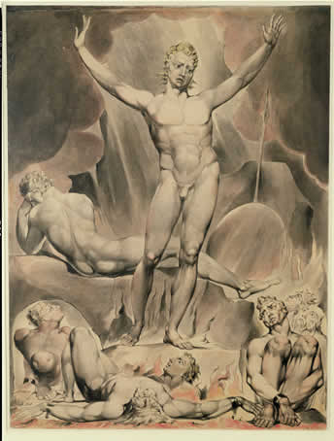
“The Marriage of Heaven and Hell”
Good ≠passivity
Evil ≠energy
Warring of Reason and Imagination
http://www.wwnorton.com/college/english/nael/romantic/topic_5/illustrations.htm

Slide 51
The Argument
Rintrah roars & shakes his fires in the burdend air;
Hungry clouds swag on the deep.
Once meek, and in a perilous path,
The just man kept his course along
The vale of death.
Roses are planted where thorns grow,
And on the barren heath
Sing the honey bees.
………………………

Slide 52
The voice of the devil
All Bibles or sacred codes have been the causes of the following Errors:
1. That Man has two real existing principles; Viz: a Body & a Soul.
2. That Energy, calld Evil, is alone from the Body, & that Reason, calld Good, is alone from the Soul.
3. That God will torment Man in Eternity for following his Energies.

Slide 53
The voice of the devil
But the following Contraries to these are True:
1. Man has no Body distinct from his Soul; for that calld Body is a portion of Soul discernd by five Senses, the chief inlets of Soul in this age.
2. Energy is the only life, and is from the Body; and Reason is the bound or outward circumference of Energy.
3. Energy is Eternal Delight.
………………………

Slide 54
Proverbs of hell
In seed time learn, in harvest teach, in winter enjoy.
Drive your cart and your plow over the bones of the dead.
The road of excess leads to the palace of wisdom.
Prudence is a rich ugly old maid courted by Incapacity.
He who desires but acts not, breeds pestilence.
………………………

Slide 55
A memorable fancy
I was in a Printing house in Hell & saw the method in which knowledge is transmitted from generation to generation.
In the first chamber was a Dragon-Man, clearing away the rubbish from a cave’s mouth; within, a number of Dragons were hollowing the cave.
In the second chamber was a Viper folding round the rock & the cave, and others adorning it with gold, silver, and precious stones.

Slide 56
A memorable fancy
In the third chamber was an Eagle with wings and feathers of air; he caused the inside of the cave to be infinite; around were numbers of Eagle-like men, who built palaces in the immense cliffs.
In the fourth chamber were Lions of flaming fire, raging around & melting the metals into living fluids.
In the fifth chamber were Unnam’d forms, which cast the metals into the expanse.

Slide 57
A memorable fancy
There they were receiv’d by Men who occupied the sixth chamber, and took the forms of books & were arranged in libraries.
………………………

Slide 58
A memorable fancy (page 1440)
………………………
……I tell you, no virtue can exist without breaking these ten commandments. Jesus was all virtue, and acted from im[PLATE 24]pulse, not from rules.”
………………………

Slide 59
Question
How would you define the English Romanticism? Can you cite examples to support your explanation?

Slide 60
The End

